Slide 1
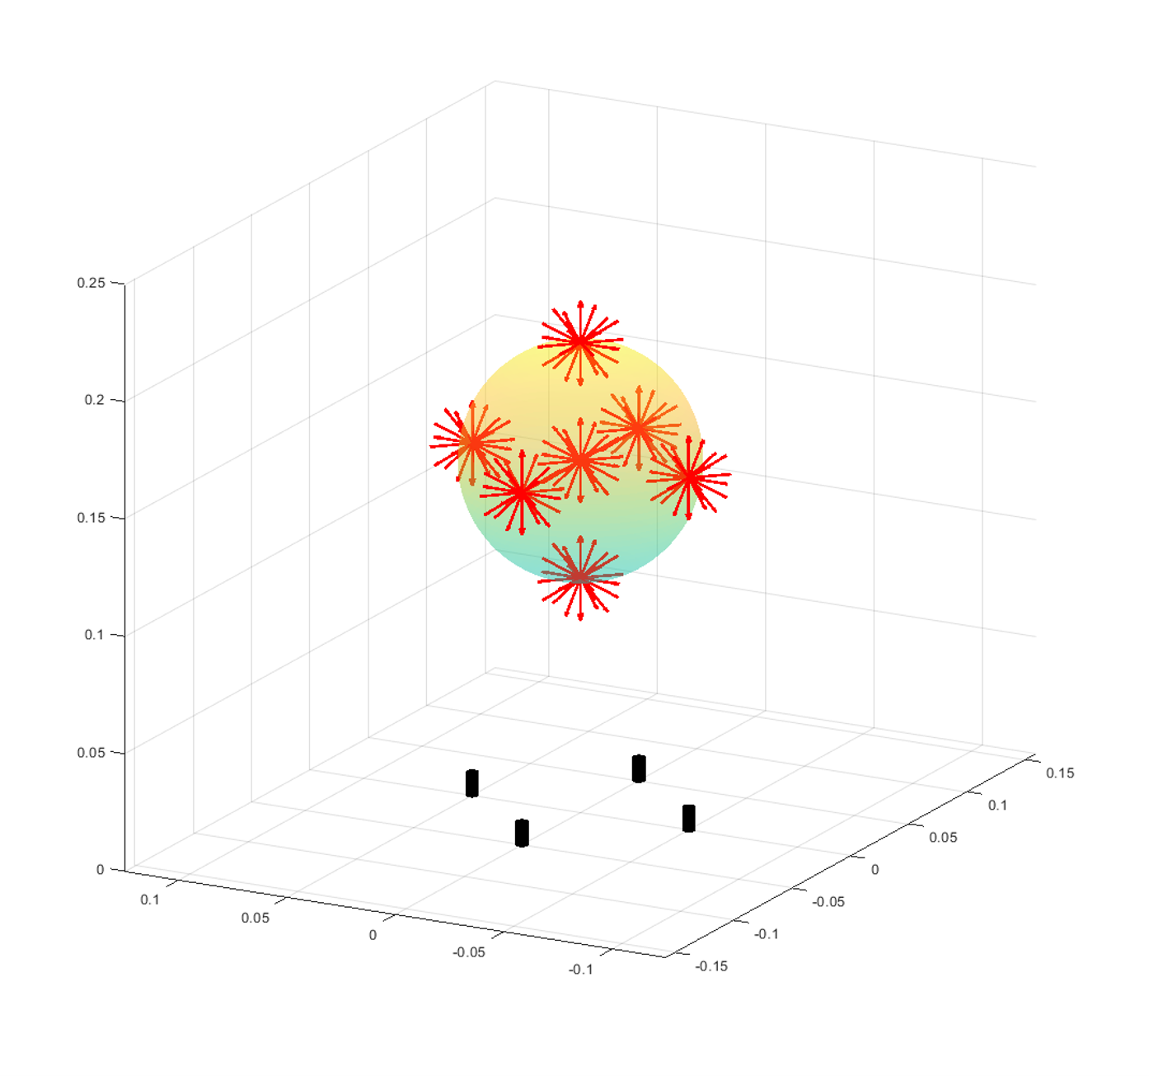
Hypothesis and test configuration
Hypothesis: If the singular value is higher, the same motion will generate a bigger signal compared to the noise level. The algorithm will converge closer to the ground truth when noise presents.
Test configuration: the red arrows are all the magnet configurations where we record the magnetic field. 7 positions are considered, at each position, 32 orientations are considered, resulting in 224 configurations in total. The 4 black cylinders are an example of the sensor put on a 5cm circle.
To ensure convergence, the algorithm starts the initial guess at the nominal configuration (close enough to the solution).

Slide 2
Radius = 5cm, before calibration
$${p=\left[0;0;0.20m\right], Mean(σ}_{mean})=1.15e−5, Mean\left(e_{p}\right)=7.41mm, Mean\left(e_{R}\right)={4.52}^{°}$$
$${p=\left[0;−0.05m;0.15m\right], Mean(σ}_{mean})=2.78e−5, Mean\left(e_{p}\right)=4.56mm, Mean\left(e_{R}\right)={3.91}^{°}$$
$${p=\left[−0.05m;0;0.15m\right], Mean(σ}_{mean})=2.77e−5, Mean\left(e_{p}\right)=6.11mm, Mean\left(e_{R}\right)={3.83}^{°}$$
$${p=\left[0;0.05;0.15m\right], Mean(σ}_{mean})=2.78e−5, Mean\left(e_{p}\right)=5.68mm, Mean\left(e_{R}\right)={4.36}^{°}$$
$${p=\left[0.05m;0;0.15m\right], Mean(σ}_{mean})=2.77e−5, Mean\left(e_{p}\right)=5.11mm, Mean\left(e_{R}\right)={3.55}^{°}$$
$${p=\left[0;0;0.15m\right], Mean(σ}_{mean})=3.11e−5, Mean\left(e_{p}\right)=5.19mm, Mean\left(e_{R}\right)={3.20}^{°}$$
$${p=\left[0;0;0.1m\right], Mean(σ}_{mean})=1.20e−4, Mean\left(e_{p}\right)=5.09mm, Mean\left(e_{R}\right)={2.24}^{°}$$
Overall: ${Mean(σ}_{mean})=3.90e−5,Mean\left(e_{p}\right)=5.59mm, Mean\left(e_{R}\right)={3.66}^{°}$

Slide 3

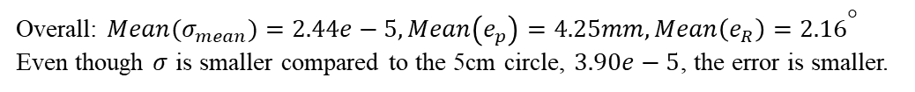
Radius = 10cm, before calibration
$${p=\left[0;0;0.20m\right], Mean(σ}_{mean})=9.31e−6, Mean\left(e_{p}\right)=5.08mm, Mean\left(e_{R}\right)={2.76}^{°}$$
$${p=\left[0;−0.05m;0.15m\right], Mean(σ}_{mean})=2.16e−5, Mean\left(e_{p}\right)=3.94mm, Mean\left(e_{R}\right)={2.15}^{°}$$
$${p=\left[−0.05m;0;0.15m\right], Mean(σ}_{mean})=2.16e−5, Mean\left(e_{p}\right)=4.63mm, Mean\left(e_{R}\right)={1.79}^{°}$$
$${p=\left[0;0.05;0.15m\right], Mean(σ}_{mean})=2.16e−5, Mean\left(e_{p}\right)=4.11mm, Mean\left(e_{R}\right)={2.66}^{°}$$
$${p=\left[0.05m;0;0.15m\right], Mean(σ}_{mean})=2.16e−5, Mean\left(e_{p}\right)=3.44mm, Mean\left(e_{R}\right)={1.80}^{°}$$
$${p=\left[0;0;0.15m\right], Mean(σ}_{mean})=2.11e−5, Mean\left(e_{p}\right)=4.26mm, Mean\left(e_{R}\right)={2.21}^{°}$$
$${p=\left[0;0;0.1m\right], Mean(σ}_{mean})=5.40e−5, Mean\left(e_{p}\right)=4.30mm, Mean\left(e_{R}\right)={1.77}^{°}$$
Overall: ${Mean(σ}_{mean})=2.44e−5,Mean\left(e_{p}\right)=4.25mm, Mean\left(e_{R}\right)={2.16}^{°}$
Even though $σ$ is smaller compared to the 5cm circle, $3.90e−5$, the error is smaller.

Slide 4
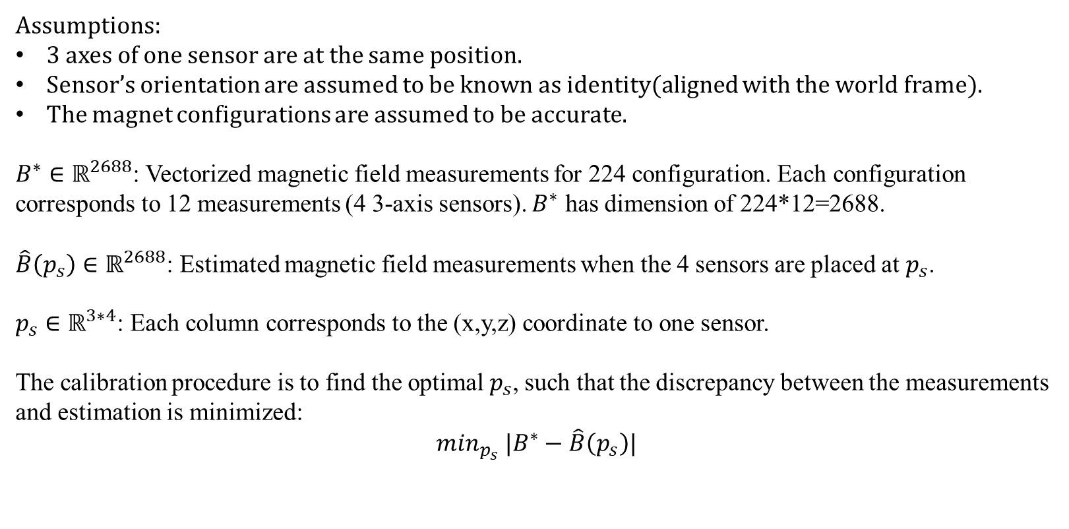
Calibration
Assumptions:
3 axes of one sensor are at the same position.
Sensor’s orientation are assumed to be known as identity(aligned with the world frame).
The magnet configurations are assumed to be accurate.
$B^{∗}∈ℝ^{2688}$: Vectorized magnetic field measurements for 224 configuration. Each configuration corresponds to 12 measurements (4 3-axis sensors). $B^{∗}$ has dimension of 224*12=2688.
$\hat{B}\left(p_{s}\right)∈ℝ^{2688}$: Estimated magnetic field measurements when the 4 sensors are placed at $p_{s}$.
$p_{s}∈ℝ^{3∗4}$: Each column corresponds to the (x,y,z) coordinate to one sensor.
The calibration procedure is to find the optimal $p_{s}$, such that the discrepancy between the measurements and estimation is minimized:
$$\min_{p_{s}} |B^{∗}−\hat{B}\left(p_{s}\right)|$$

Slide 5


Calibration result
$$p_{s_{5cm}}^{∗}=$$
5cm:
$$mean\left(\left|B^{∗}−\hat{B}\left(p_{s}\right)\right|\right): 0.6075μT→0.3563μT$$
$$p_{s_{10cm}}^{∗}=$$
10cm:
$$mean\left(\left|B^{∗}−\hat{B}\left(p_{s}\right)\right|\right): 0.3447μT→0.2232μT$$

Slide 6
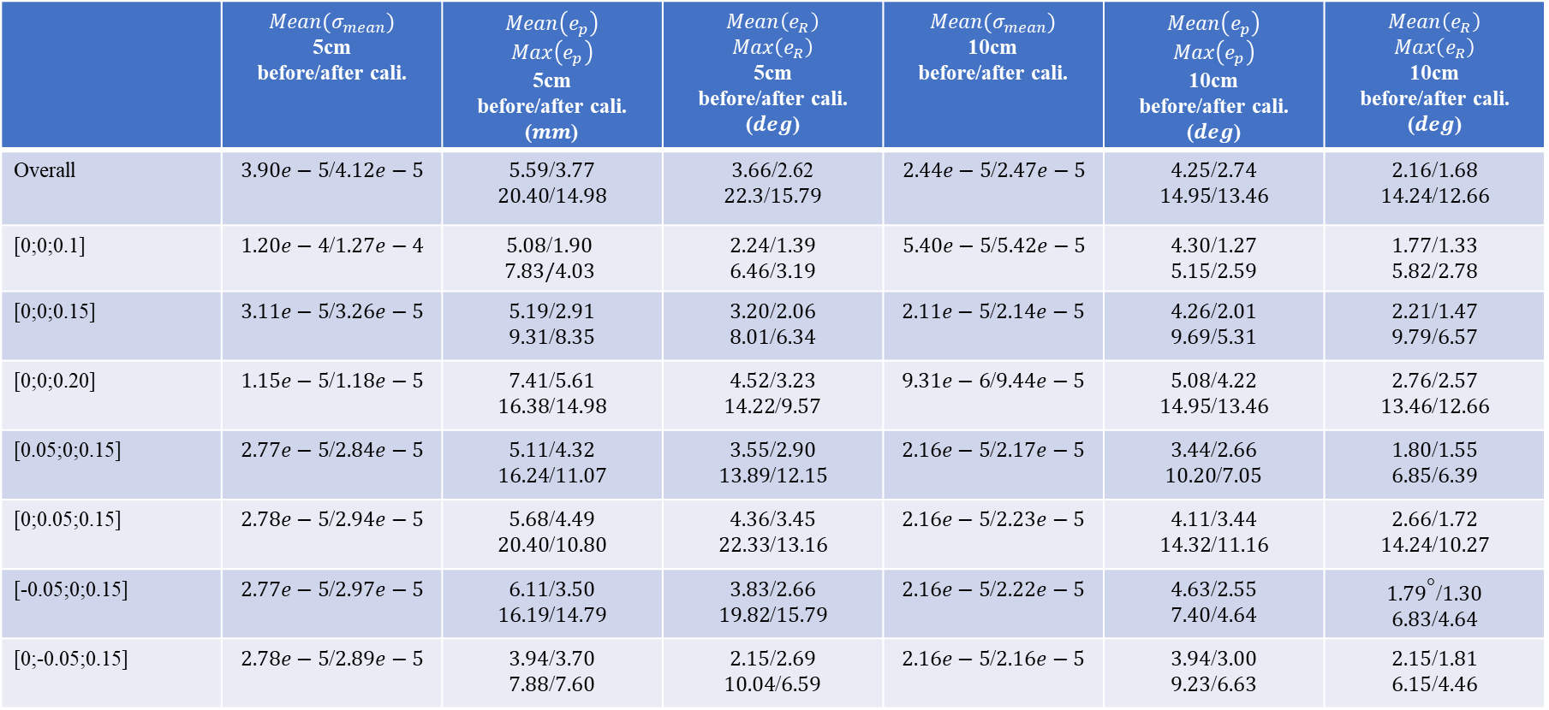
Comparison
 | $${Mean(σ}_{mean})$$ 5cm before/after cali. | $$Mean\left(e_{p}\right)$$ $$Max\left(e_{p}\right)$$ 5cm before/after cali. ($mm$) | $$Mean\left(e_{R}\right)$$ $$Max\left(e_{R}\right)$$ 5cm before/after cali. ($deg$) | $${Mean(σ}_{mean})$$ 10cm before/after cali. | $$Mean\left(e_{p}\right)$$ $$Max\left(e_{p}\right)$$ 10cm before/after cali. ($deg$) | $$Mean\left(e_{R}\right)$$ $$Max\left(e_{R}\right)$$ 10cm before/after cali. ($deg$)
Overall | $3.90e−5$/$4.12e−5$ | $5.59$/$3.77$ $20.40$/$14.98$ | $3.66$/2.62 $22.3$/$15.79$ | $2.44e−5$/$2.47e−5$ | $4.25$/$2.74$ $14.95$/$13.46$ | $2.16$/$1.68$ $14.24$/$12.66$
[0;0;0.1] | $1.20e−4$/$1.27e−4$ | $5.08$/$1.90$ $$7.83/4.03$$ | $2.24$/$1.39$ $6.46$/$3.19$ | $5.40e−5$/$5.42e−5$ | $4.30$/$1.27$ $5.15$/$2.59$ | $1.77$/$1.33$ $5.82$/$2.78$
[0;0;0.15] | $3.11e−5$/$3.26e−5$ | $5.19$/$2.91$ $9.31$/$8.35$ | $3.20$/$2.06$ $8.01$/$6.34$ | $2.11e−5$/$2.14e−5$ | $4.26$/$2.01$ $9.69$/$5.31$ | $2.21$/$1.47$ $9.79$/$6.57$
[0;0;0.20] | $1.15e−5$/$1.18e−5$ | $7.41$/$5.61$ $16.38$/$14.98$ | $4.52$/$3.23$ $14.22$/$9.57$ | $9.31e−6$/$9.44e−5$ | $5.08$/$4.22$ $14.95$/$13.46$ | $2.76$/$2.57$ $13.46$/$12.66$
[0.05;0;0.15] | $2.77e−5$/$2.84e−5$ | $5.11$/$4.32$ $16.24$/$11.07$ | $3.55$/$2.90$ $13.89$/$12.15$ | $2.16e−5$/$2.17e−5$ | $3.44$/$2.66$ $10.20$/$7.05$ | $1.80$/$1.55$ $6.85$/$6.39$
[0;0.05;0.15] | $2.78e−5$/$2.94e−5$ | $5.68$/$4.49$ $20.40$/$10.80$ | $4.36$/$3.45$ $22.33$/$13.16$ | $2.16e−5$/$2.23e−5$ | $4.11$/$3.44$ $14.32$/$11.16$ | $2.66$/$1.72$ $14.24$/$10.27$
[-0.05;0;0.15] | $2.77e−5$/$2.97e−5$ | $6.11$/$3.50$ $16.19$/$14.79$ | $3.83$/$2.66$ $19.82$/$15.79$ | $2.16e−5$/$2.22e−5$ | $4.63$/$2.55$ $7.40$/$4.64$ | ${1.79}^{}$/$1.30$ $6.83$/$4.64$
[0;-0.05;0.15] | $2.78e−5$/$2.89e−5$ | $3.94$/$3.70$ $7.88$/$7.60$ | $2.15$/$2.69$ $10.04$/$6.59$ | $2.16e−5$/$2.16e−5$ | $3.94$/$3.00$ $9.23$/$6.63$ | $2.15$/$1.81$ $6.15$/$4.46$

Slide 7
Comparison
For all the configurations, the singular value is higher for the 5cm circle than that for the 10cm circle, the hypothesis suggests the error after convergence would be smaller for a 5cm circle. But the experiment shows that the error is higher for a 5cm circle, with or without calibration.

Slide 8
“Convergence ball” test
Hypothesis: starting from different initial guess, the configuration with higher singular value will converge to a smaller “sphere” that is closer to the ground truth.
But
Observation: As long as the algorithm converges, it converges to the same optima no matter where the initial guess is.
Hypothesis changes: given multiple noisy measurement, starting the initial guess at the ground truth configuration to ensure convergence, the error after convergence is smaller for the config that has a higher singular value.
10 noisy measurements are taken for each configuration. The 10 errors are averaged for each configuration and the errors for all configurations are averaged to get the overall performance.

Slide 9
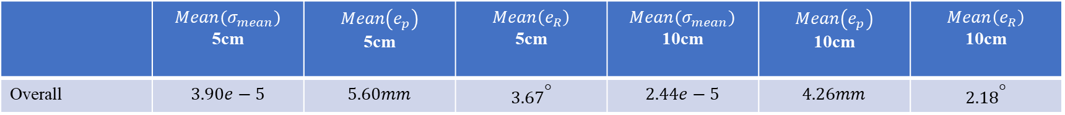
“Convergence ball” test
 | $${Mean(σ}_{mean})$$ 5cm | $$Mean\left(e_{p}\right)$$ 5cm | $$Mean\left(e_{R}\right)$$ 5cm | $${Mean(σ}_{mean})$$ 10cm | $$Mean\left(e_{p}\right)$$ 10cm | $$Mean\left(e_{R}\right)$$ 10cm
Overall | $$3.90e−5$$ | $$5.60mm$$ | $${3.67}^{}$$ | $$2.44e−5$$ | $$4.26mm$$ | $${2.18}^{}$$
The result is very close to the one on page 4. In face, running the algorithm for 10 different noisy measurements is essentially equivalent to taking the average of 10 noisy measurements and then run the algorithm. Still, the configuration with larger singular value has larger error.

Slide 10
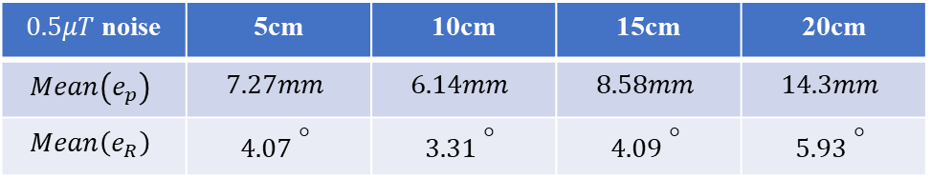
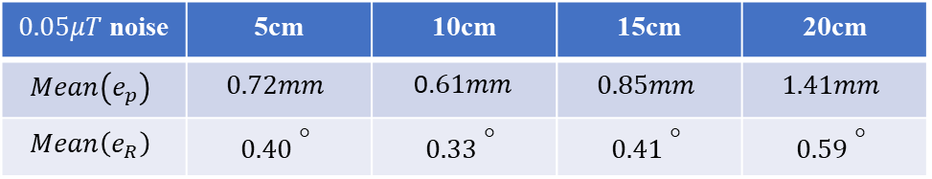
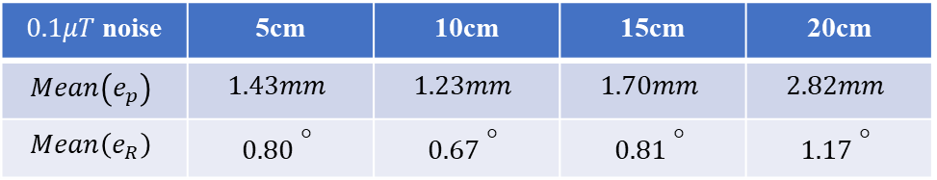
Simulation
To further confirm the phenomenon, simulated experiment is done. For the same magnet configuration, add different level of random noise to the simulated sensor reading. Run the algorithm for 100 times. Compute the mean errors after convergence. Turns out that 10cm of a circle is better than not only 5cm, but also 15cm and 20cm.
$0.5μT$ noise | 5cm | 10cm | 15cm | 20cm
$$Mean\left(e_{p}\right)$$ | $$7.27mm$$ | $$6.14mm$$ | $$8.58mm$$ | $$14.3mm$$
$$Mean\left(e_{R}\right)$$ | $${4.07 }^{}$$ | $${3.31 }^{}$$ | $${4.09 }^{}$$ | $${5.93 }^{}$$
$0.1μT$ noise | 5cm | 10cm | 15cm | 20cm
$$Mean\left(e_{p}\right)$$ | $$1.43mm$$ | $$1.23mm$$ | $$1.70mm$$ | $$2.82mm$$
$$Mean\left(e_{R}\right)$$ | $${0.80 }^{}$$ | $${0.67 }^{}$$ | $${0.81 }^{}$$ | $${1.17 }^{}$$
$0.05μT$ noise | 5cm | 10cm | 15cm | 20cm
$$Mean\left(e_{p}\right)$$ | $$0.72mm$$ | 0.$61mm$ | $$0.85mm$$ | $$1.41mm$$
$$Mean\left(e_{R}\right)$$ | $${0.40 }^{}$$ | $${0.33 }^{}$$ | $${0.41 }^{}$$ | $${0.59 }^{}$$

Slide 11
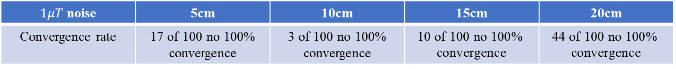
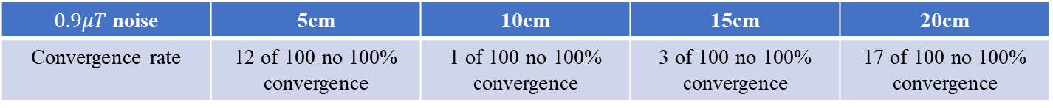
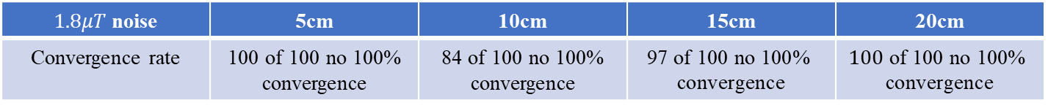
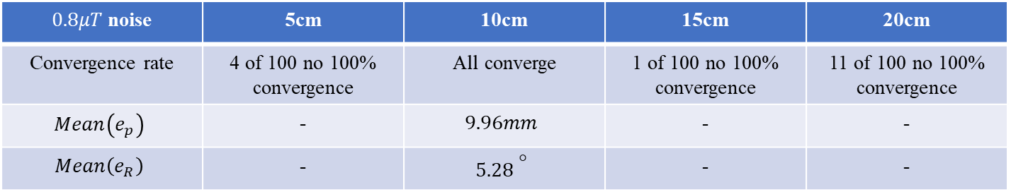
Simulation
Further increase the noise level to check if at some point 5cm will outperform 10cm because the noise corrupted the 10cm measurements more than 5cm. However, even when the noise level increases to a point where not all 100 testing trials converge 100%(even though we start at the ground truth config), the number of not 100% convergence trials is less for the 10cm circle.
$0.8μT$ noise | 5cm | 10cm | 15cm | 20cm
Convergence rate | 4 of 100 no 100% convergence | All converge | 1 of 100 no 100% convergence | 11 of 100 no 100% convergence
$$Mean\left(e_{p}\right)$$ | - | $$9.96mm$$ | - | -
$$Mean\left(e_{R}\right)$$ | - | $${5.28 }^{}$$ | - | -
$0.9μT$ noise | 5cm | 10cm | 15cm | 20cm
Convergence rate | 12 of 100 no 100% convergence | 1 of 100 no 100% convergence | 3 of 100 no 100% convergence | 17 of 100 no 100% convergence
$1μT$ noise | 5cm | 10cm | 15cm | 20cm
Convergence rate | 17 of 100 no 100% convergence | 3 of 100 no 100% convergence | $$\text{10} \text{of}\text{ 100 }\text{no}\text{ 100\% }\text{convergence}$$ | $$\text{44} \text{of}\text{ 100 }\text{no}\text{ 100\% }\text{convergence}$$
$1.8μT$ noise | 5cm | 10cm | 15cm | 20cm
Convergence rate | 100 of 100 no 100% convergence | 84 of 100 no 100% convergence | $$\text{97} \text{of}\text{ 100 }\text{no}\text{ 100\% }\text{convergence}$$ | $$\text{100} \text{of}\text{ 100 }\text{no}\text{ 100\% }\text{convergence}$$

Slide 12
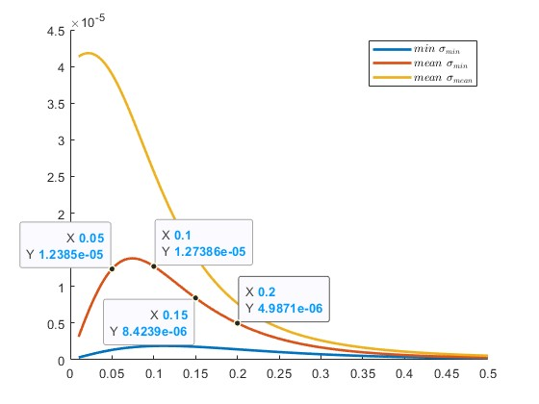

$σ_{min}$ instead of $σ_{mean}$
Observation: In the previous simulation, 10cm has a larger $mean(σ_{min})$ than 5cm, 15cm, and 20cm. And it has the least error.
Hypothesis: Instead of $σ_{mean}$, $σ_{min}$ is the one that corresponds to how well the algorithm can converge when noise presents.
Reason: When the algorithm approaches the minima, it will approach in the minimum change direction(where the gradient vanishes), which is specified by the $v_{min}$, the singular vector corresponds to $σ_{min}$. When $σ_{min}$ is larger, a small change in configuration will lead to a large change in the error, the update step calculate will be higher than that of a smaller $σ_{min}$. As a result, the algorithm will keep running even when it is close to the ground truth. Eventually, it will converge closer to the ground truth when noise is presented.

Slide 13
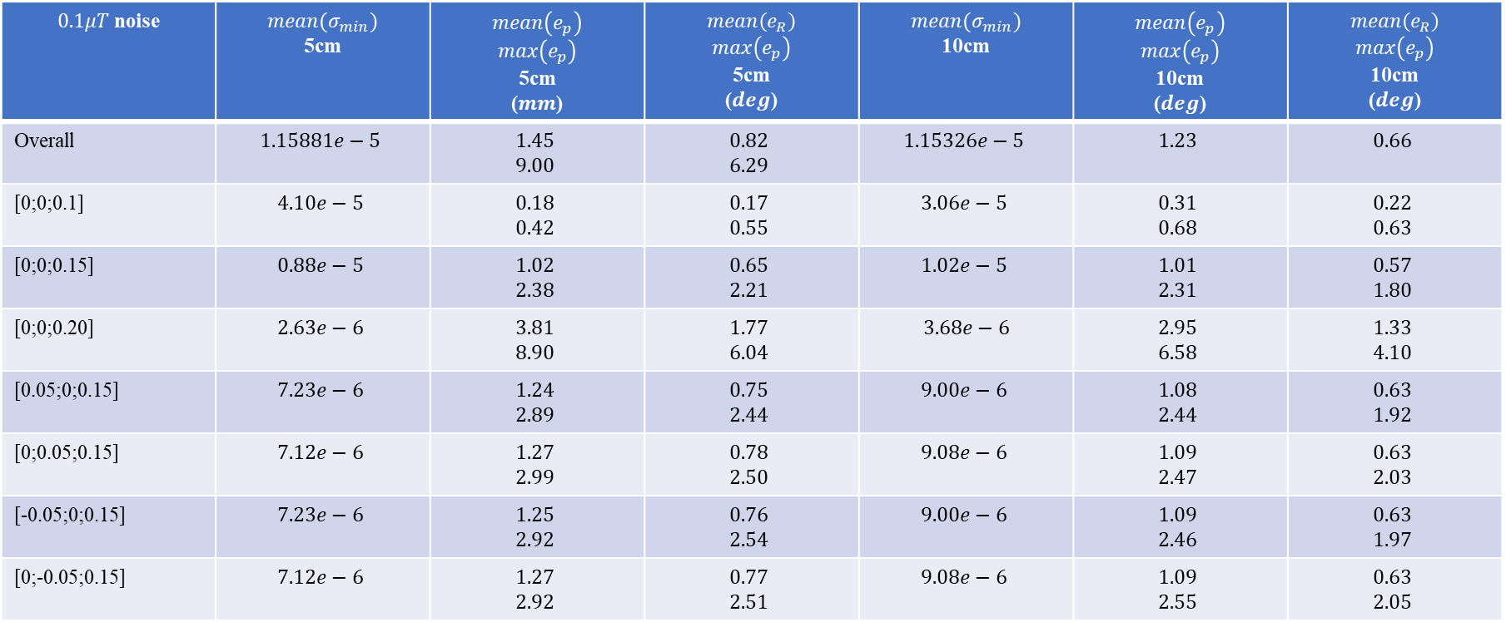
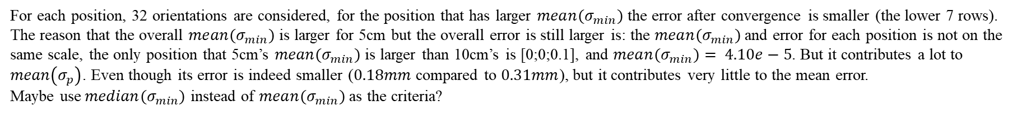
Comparison - $mean(σ_{min})$ in simulation
$0.1μT$ noise | $${mean(σ}_{min})$$ 5cm | $$mean\left(e_{p}\right)$$ $$max\left(e_{p}\right)$$ 5cm ($mm$) | $$mean\left(e_{R}\right)$$ $$max\left(e_{p}\right)$$ 5cm ($deg$) | $${mean(σ}_{min})$$ 10cm | $$mean\left(e_{p}\right)$$ $$max\left(e_{p}\right)$$ 10cm ($deg$) | $$mean\left(e_{R}\right)$$ $$max\left(e_{p}\right)$$ 10cm ($deg$)
Overall | $$1.15881e−5$$ | $$1.45$$ $$9.00$$ | $$0.82$$ $$6.29$$ | $$1.15326e−5$$ | $$1.23$$ | $$0.66$$
[0;0;0.1] | $$4.10e−5$$ | $$0.18$$ $$0.42$$ | $$0.17$$ $$0.55$$ | $$3.06e−5$$ | $$0.31$$ $$0.68$$ | $$0.22$$ $$0.63$$
[0;0;0.15] | $$0.88e−5$$ | $$1.02$$ $$2.38$$ | $$0.65$$ $$2.21$$ | $$1.02e−5$$ | $$1.01$$ $$2.31$$ | $$0.57$$ $$1.80$$
[0;0;0.20] | $$2.63e−6$$ | $$3.81$$ $$8.90$$ | $$1.77$$ $$6.04$$ | $$3.68e−6$$ | $$2.95$$ $$6.58$$ | $$1.33$$ $$4.10$$
[0.05;0;0.15] | $$7.23e−6$$ | $$1.24$$ $$2.89$$ | $$0.75$$ $$2.44$$ | $$9.00e−6$$ | $$1.08$$ $$2.44$$ | $$0.63$$ $$1.92$$
[0;0.05;0.15] | $$7.12e−6$$ | $$1.27$$ $$2.99$$ | $$0.78$$ $$2.50$$ | $$9.08e−6$$ | $$1.09$$ $$2.47$$ | $$0.63$$ $$2.03$$
[-0.05;0;0.15] | $$7.23e−6$$ | $$1.25$$ $$2.92$$ | $$0.76$$ $$2.54$$ | $$9.00e−6$$ | $$1.09$$ $$2.46$$ | $$0.63$$ $$1.97$$
[0;-0.05;0.15] | $$7.12e−6$$ | $$1.27$$ $$2.92$$ | $$0.77$$ $$2.51$$ | $$9.08e−6$$ | $$1.09$$ $$2.55$$ | $$0.63$$ $$2.05$$
For each position, 32 orientations are considered, for the position that has larger ${mean(σ}_{min})$ the error after convergence is smaller (the lower 7 rows). The reason that the overall ${mean(σ}_{min})$ is larger for 5cm but the overall error is still larger is: the ${mean(σ}_{min})$ and error for each position is not on the same scale, the only position that 5cm’s ${mean(σ}_{min})$ is larger than 10cm’s is [0;0;0.1], and ${mean(σ}_{min})= 4.10e−5$. But it contributes a lot to $mean\left(σ_{p}\right)$. Even though its error is indeed smaller ($0.18mm$ compared to $0.31mm$), but it contributes very little to the mean error.
Maybe use${median(σ}_{min})$ instead of ${mean(σ}_{min})$ as the criteria?

Slide 14
Comparison - $mean(σ_{min})$ in simulation
Further simulation is done for different magnet configurations, different sizes of circle, and different number of sensors. They all confirmed the fact that for the configurations with larger $σ_{min}$, the algorithm converges better.

Slide 15
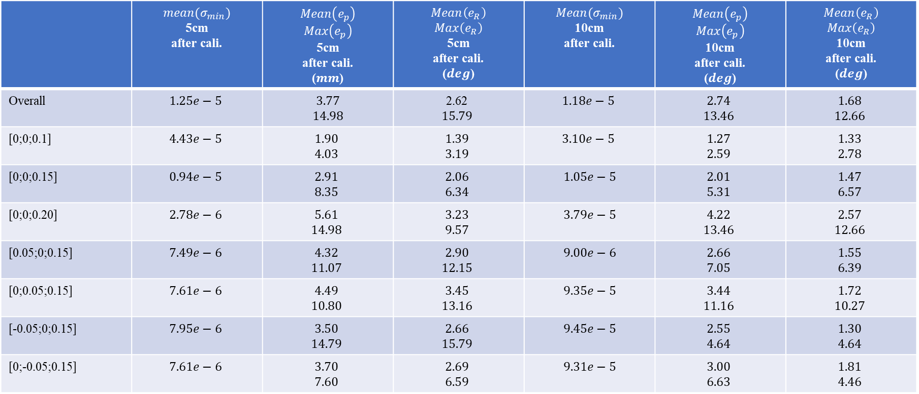
Comparison - experiment
 | $${mean(σ}_{min})$$ 5cm after cali. | $$Mean\left(e_{p}\right)$$ $$Max\left(e_{p}\right)$$ 5cm after cali. ($mm$) | $$Mean\left(e_{R}\right)$$ $$Max\left(e_{R}\right)$$ 5cm after cali. ($deg$) | $${Mean(σ}_{min})$$ 10cm after cali. | $$Mean\left(e_{p}\right)$$ $$Max\left(e_{p}\right)$$ 10cm after cali. ($deg$) | $$Mean\left(e_{R}\right)$$ $$Max\left(e_{R}\right)$$ 10cm after cali. ($deg$)
Overall | $$1.25e−5$$ | $$3.77$$ $$14.98$$ | 2.62 $$15.79$$ | $$1.18e−5$$ | $$2.74$$ $$13.46$$ | $$1.68$$ $$12.66$$
[0;0;0.1] | $$4.43e−5$$ | $$1.90$$ $$4.03$$ | $$1.39$$ $$3.19$$ | $$3.10e−5$$ | $$1.27$$ $$2.59$$ | $$1.33$$ $$2.78$$
[0;0;0.15] | $$0.94e−5$$ | $$2.91$$ $$8.35$$ | $$2.06$$ $$6.34$$ | $$1.05e−5$$ | $$2.01$$ $$5.31$$ | $$1.47$$ $$6.57$$
[0;0;0.20] | $$2.78e−6$$ | $$5.61$$ $$14.98$$ | $$3.23$$ $$9.57$$ | $$3.79e−5$$ | $$4.22$$ $$13.46$$ | $$2.57$$ $$12.66$$
[0.05;0;0.15] | $$7.49e−6$$ | $$4.32$$ $$11.07$$ | $$2.90$$ $$12.15$$ | $$9.00e−6$$ | $$2.66$$ $$7.05$$ | $$1.55$$ $$6.39$$
[0;0.05;0.15] | $$7.61e−6$$ | $$4.49$$ $$10.80$$ | $$3.45$$ $$13.16$$ | $$9.35e−5$$ | $$3.44$$ $$11.16$$ | $$1.72$$ $$10.27$$
[-0.05;0;0.15] | $$7.95e−6$$ | $$3.50$$ $$14.79$$ | $$2.66$$ $$15.79$$ | $$9.45e−5$$ | $$2.55$$ $$4.64$$ | $$1.30$$ $$4.64$$
[0;-0.05;0.15] | $$7.61e−6$$ | $$3.70$$ $$7.60$$ | $$2.69$$ $$6.59$$ | $$9.31e−5$$ | $$3.00$$ $$6.63$$ | $$1.81$$ $$4.46$$
For [0;0;0.1], the ${mean(σ}_{min})$ is larger but the error is still bigger in experiment. There are many possible reasons: bias in the sensor reading, non-perfect calibration, etc. Other than this position, all other positions verify the hypothesis that whenever ${mean(σ}_{min})$ is higher, the algorithm converges better.

Slide 16
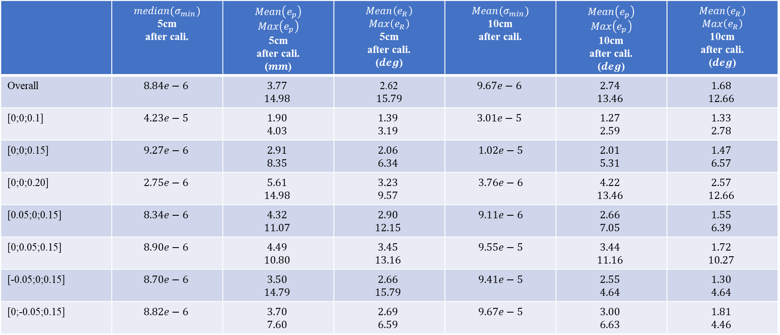
Comparison - experiment
 | $${median(σ}_{min})$$ 5cm after cali. | $$Mean\left(e_{p}\right)$$ $$Max\left(e_{p}\right)$$ 5cm after cali. ($mm$) | $$Mean\left(e_{R}\right)$$ $$Max\left(e_{R}\right)$$ 5cm after cali. ($deg$) | $${Mean(σ}_{min})$$ 10cm after cali. | $$Mean\left(e_{p}\right)$$ $$Max\left(e_{p}\right)$$ 10cm after cali. ($deg$) | $$Mean\left(e_{R}\right)$$ $$Max\left(e_{R}\right)$$ 10cm after cali. ($deg$)
Overall | $$8.84e−6$$ | $$3.77$$ $$14.98$$ | 2.62 $$15.79$$ | $$9.67e−6$$ | $$2.74$$ $$13.46$$ | $$1.68$$ $$12.66$$
[0;0;0.1] | $$4.23e−5$$ | $$1.90$$ $$4.03$$ | $$1.39$$ $$3.19$$ | $$3.01e−5$$ | $$1.27$$ $$2.59$$ | $$1.33$$ $$2.78$$
[0;0;0.15] | $$9.27e−6$$ | $$2.91$$ $$8.35$$ | $$2.06$$ $$6.34$$ | $$1.02e−5$$ | $$2.01$$ $$5.31$$ | $$1.47$$ $$6.57$$
[0;0;0.20] | $$2.75e−6$$ | $$5.61$$ $$14.98$$ | $$3.23$$ $$9.57$$ | $$3.76e−6$$ | $$4.22$$ $$13.46$$ | $$2.57$$ $$12.66$$
[0.05;0;0.15] | $$8.34e−6$$ | $$4.32$$ $$11.07$$ | $$2.90$$ $$12.15$$ | $$9.11e−6$$ | $$2.66$$ $$7.05$$ | $$1.55$$ $$6.39$$
[0;0.05;0.15] | $$8.90e−6$$ | $$4.49$$ $$10.80$$ | $$3.45$$ $$13.16$$ | $$9.55e−5$$ | $$3.44$$ $$11.16$$ | $$1.72$$ $$10.27$$
[-0.05;0;0.15] | $$8.70e−6$$ | $$3.50$$ $$14.79$$ | $$2.66$$ $$15.79$$ | $$9.41e−5$$ | $$2.55$$ $$4.64$$ | $$1.30$$ $$4.64$$
[0;-0.05;0.15] | $$8.82e−6$$ | $$3.70$$ $$7.60$$ | $$2.69$$ $$6.59$$ | $$9.67e−5$$ | $$3.00$$ $$6.63$$ | $$1.81$$ $$4.46$$
For [0;0;0.1], the ${mean(σ}_{min})$ is larger but the error is still bigger in experiment. There are many possible reasons: bias in the sensor reading, non-perfect calibration, etc. Other than this position, all other positions verify the hypothesis that whenever ${mean(σ}_{min})$ is higher, the algorithm converges better.

Slide 17
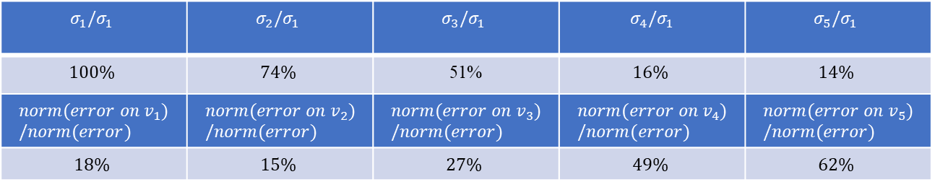
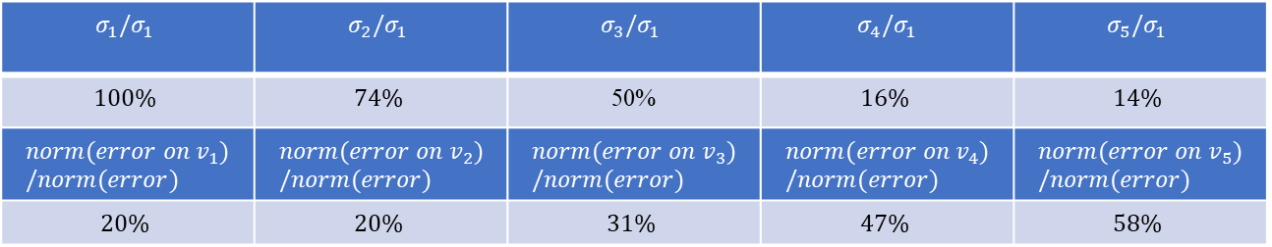
Test – projected error – simulation
Hypothesis: the magnetic field change in the direction of the 5th singular value that corresponds to $σ_{min}$ is the hardest direction to detect. When there is white noise, this is the direction that is hardest to distinguish from noise. As a result, it contributes the most to the error of configuration estimation.
$$σ_{1}/σ_{1}$$ | $$σ_{2}/σ_{1}$$ | $$σ_{3}/σ_{1}$$ | $$σ_{4}/σ_{1}$$ | $$σ_{5}/σ_{1}$$
$$100\%$$ | $$74\%$$ | 51% | $$16\%$$ | $$14\%$$
$$norm(error on v_{1})/norm(error)$$ | $$norm(error on v_{2})/norm(error)$$ | $$norm(error on v_{3})/norm(error)$$ | $$norm(error on v_{4})/norm(error)$$ | $$norm(error on v_{5})/norm(error)$$
$$18\%$$ | $$15\%$$ | $$27\%$$ | $$49\%$$ | $$62\%$$
5cm:
$$σ_{1}/σ_{1}$$ | $$σ_{2}/σ_{1}$$ | $$σ_{3}/σ_{1}$$ | $$σ_{4}/σ_{1}$$ | $$σ_{5}/σ_{1}$$
$$100\%$$ | $$74\%$$ | 50% | $$16\%$$ | $$14\%$$
$$norm(error on v_{1})/norm(error)$$ | $$norm(error on v_{2})/norm(error)$$ | $$norm(error on v_{3})/norm(error)$$ | $$norm(error on v_{4})/norm(error)$$ | $$norm(error on v_{5})/norm(error)$$
$$20\%$$ | $$20\%$$ | $$31\%$$ | $$47\%$$ | $$58\%$$
10cm:
The results explain the phenomenon that for one configuration, the larger $σ_{min}$ is, the closer the algorithm will converge to the ground truth. The singular vectors corresponding to the singular value represent the DOFs. And the magnitude of the singular values indicate how well we can resolve the DOF when there is noise.

Slide 18
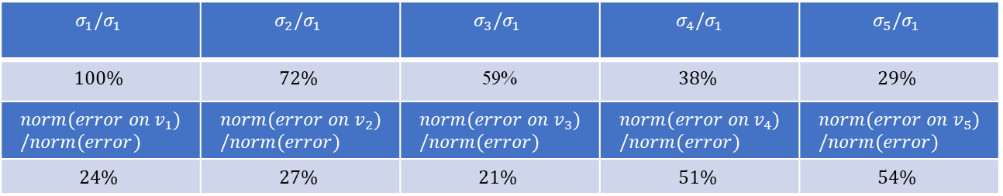
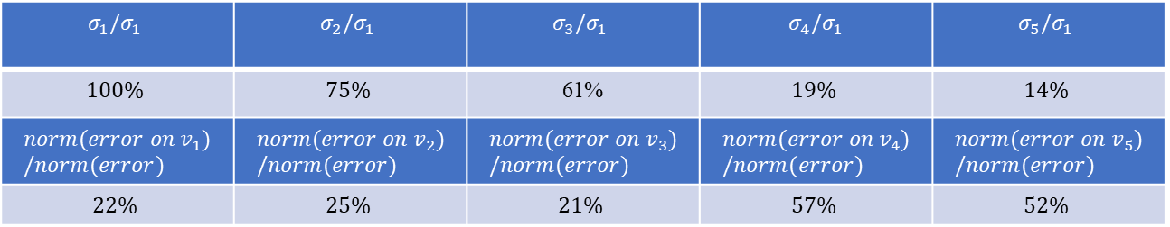
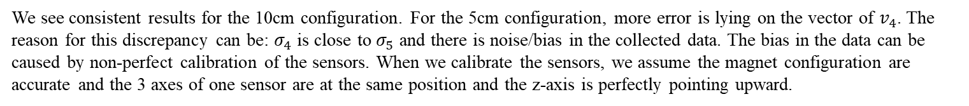
Test – projected error – experiment results
$$σ_{1}/σ_{1}$$ | $$σ_{2}/σ_{1}$$ | $$σ_{3}/σ_{1}$$ | $$σ_{4}/σ_{1}$$ | $$σ_{5}/σ_{1}$$
$$100\%$$ | $$75\%$$ | 61% | $$19\%$$ | $$14\%$$
$$norm(error on v_{1})/norm(error)$$ | $$norm(error on v_{2})/norm(error)$$ | $$norm(error on v_{3})/norm(error)$$ | $$norm(error on v_{4})/norm(error)$$ | $$norm(error on v_{5})/norm(error)$$
$$22\%$$ | $$25\%$$ | $$21\%$$ | $$57\%$$ | $$52\%$$
5cm:
$$σ_{1}/σ_{1}$$ | $$σ_{2}/σ_{1}$$ | $$σ_{3}/σ_{1}$$ | $$σ_{4}/σ_{1}$$ | $$σ_{5}/σ_{1}$$
$$100\%$$ | $$72\%$$ | 59% | $$38\%$$ | $$29\%$$
$$norm(error on v_{1})/norm(error)$$ | $$norm(error on v_{2})/norm(error)$$ | $$norm(error on v_{3})/norm(error)$$ | $$norm(error on v_{4})/norm(error)$$ | $$norm(error on v_{5})/norm(error)$$
$$24\%$$ | $$27\%$$ | $$21\%$$ | $$51\%$$ | $$54\%$$
10cm:
We see consistent results for the 10cm configuration. For the 5cm configuration, more error is lying on the vector of $v_{4}$. The reason for this discrepancy can be: $σ_{4}$ is close to $σ_{5}$ and there is noise/bias in the collected data. The bias in the data can be caused by non-perfect calibration of the sensors. When we calibrate the sensors, we assume the magnet configuration are accurate and the 3 axes of one sensor are at the same position and the z-axis is perfectly pointing upward.

